Slide 1
Perl Regular Expression And Text Processing
Primer to Perl

Slide 2
Perl Installation
Perl Installation:
sudo apt-get install perl
Installation Perl Mariadb Driver:
sudo apt-get install libdbd-mysql-perl
Installation Mariadb:
sudo apt-get update -y
sudo apt-get install mariadb-server

Slide 3
#!/usr/bin/perl
Called shebang or hashbang
First line of the program.
#! used by the kernel to ientify programs.
The hash-bang line holds the path to the Perl compiler-interpreter.

Slide 4
Perl statements
Input taken by <stdin> command.
Output given by print command.
Every statement must end with semicolon;

Slide 5
Saving and Running Perl file
Save perl files with the extension .pl.
Run perl extensions either with ./ or perl <filename>.

Slide 6
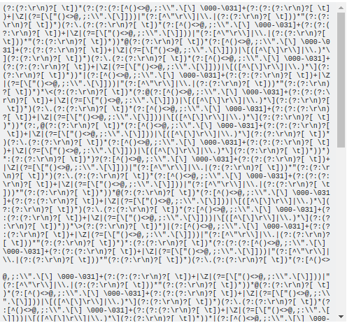
Regular Expression
Regular expression used for finding patterns in a string.
A regular expression to check whether an email is valid.

Slide 7
Regular Expression Applications.
To validate emails(data validation).
Generally used by search and replace algorithms.
Datascraping
Used in searchengines

Slide 8
Introduction to Regular Expression
=~ used for comparison.
It returns a boolean value.
Main functions of regular expression
Match Regular Expression- m//
Subsitute Regular Expression- s///
Tranliterate Regular Expression - tr///

Slide 9
Match Operation
Uses the operation m//
Can be used with m omitted.
Most simple usage of regular expression
eg
("Hello how are you" =~ /Hello/) searches for 'Hello'in the string. Returns a true value as 'Hello' is present.
("hello how are you" =~ /Hello/) searches for 'hello'in the string. Returns a false value as regular expressions are case.

Slide 10
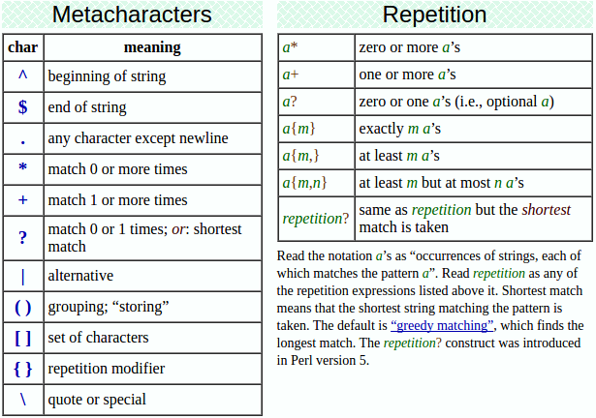

Slide 11
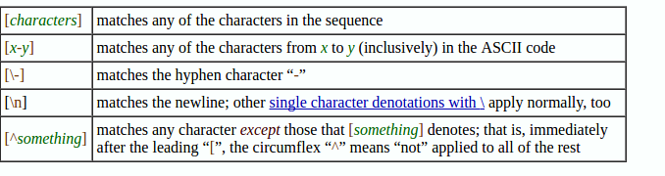

Slide 12
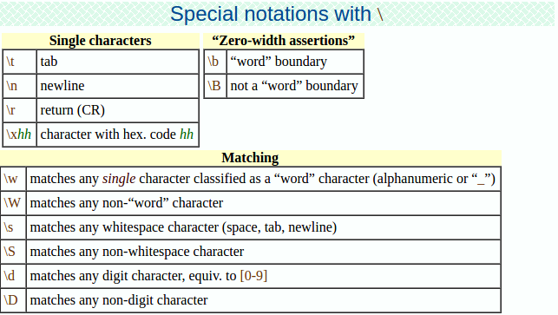

Slide 13
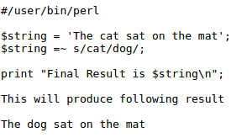
Search
s/PATTERN/REPLACEMENT/;

Slide 14
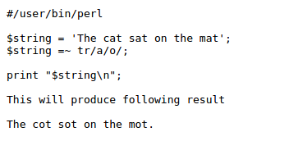
Transalation
tr /SEARCHLIST/REPLACEMENTLIST/
Not exactly a regular expression operator.
Replaces all occurence of the elements we are searching with the corresponding elements in replace list.

Slide 15
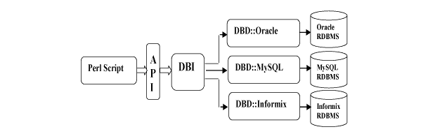
Connecting to a Database
Perl makes use of DBI (Database Independent Module) to connect to database.
DBI provides a level of abstraction between perl code and database.

Slide 16
#!/usr/bin/perl
use DBI;
use strict;
my $driver = "mysql";
my $database = "student";
my $dsn = "DBI:$driver:database=$database";
my $userid = "root"; #username, often root
my $password = ""; #your password
my $dbh = DBI->connect($dsn, $userid, $password ) or die $DBI::errstr;
my $sth = $dbh->prepare("INSERT INTO student
(name , phone )
values
('poke',111);");
$sth->execute() or die $DBI::errstr;
$sth->finish();

Slide 17


